Slide 1
Sheba
A Doctor Finder Application

Slide 2
Group Number & Members Group Number- 04
01
Md. Abdullah al Mahfuz ID- 1611869042
02
Kamrun Naher Sarna ID- 1811209642
03
Mohammed Shakiruzzaman ID- 1620180042
04
Omar Hasan Rumi ID- 1813536642

Slide 3
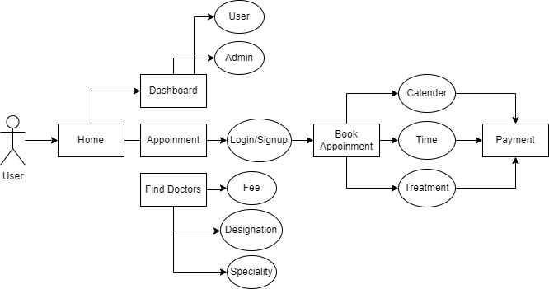
Design Flow

Slide 4
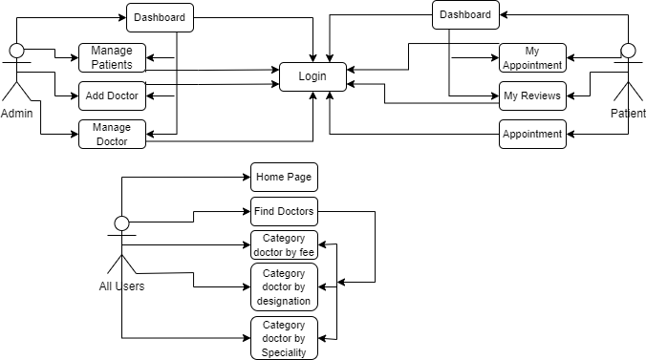
UseCase Diagram

Slide 5
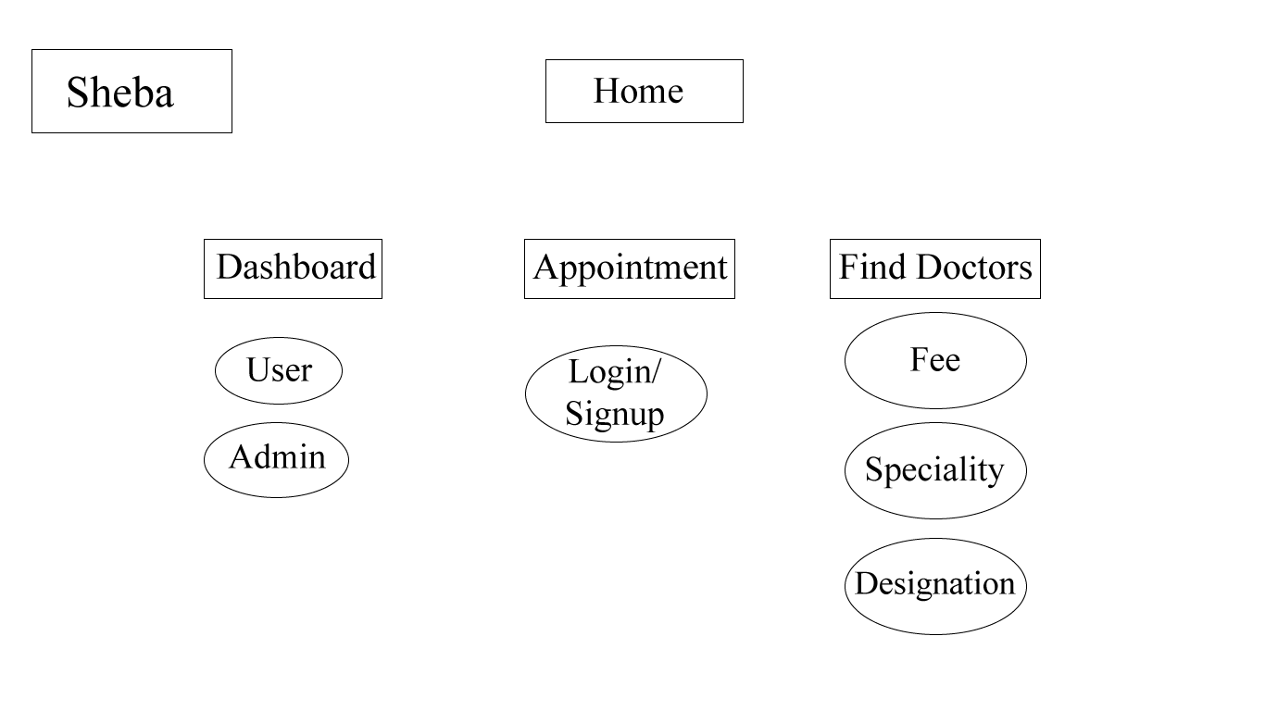

Slide 6
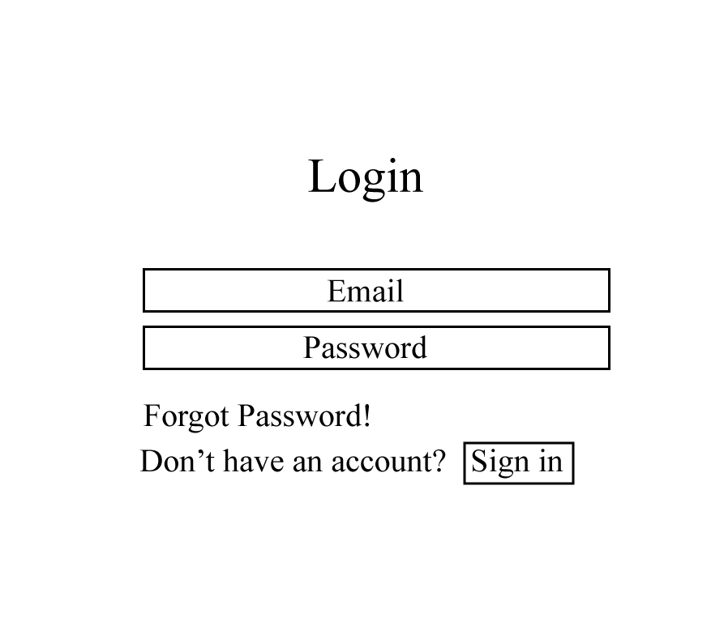
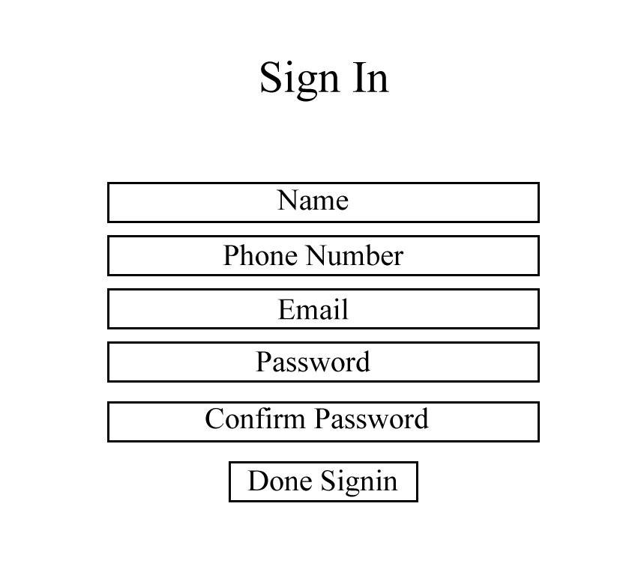

Slide 7
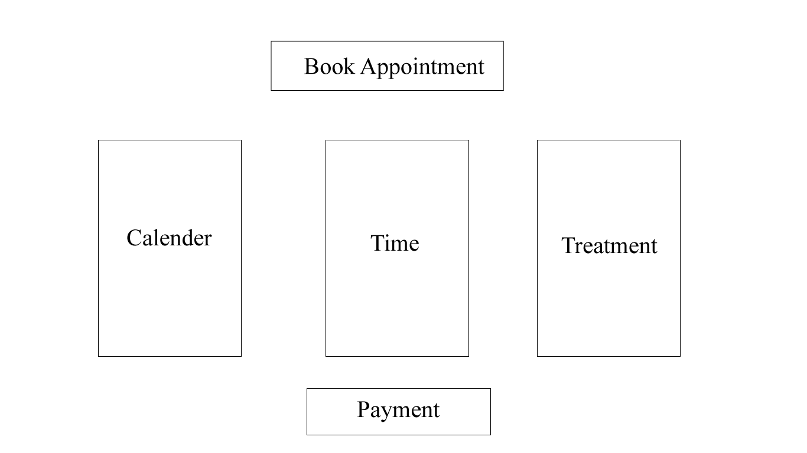

Slide 8
Thank You

